Slide 1
Whole Lotto Tokens
Project 3
Floriane Beyegue, Fareed Freihat, Josh Jaggat, Cassandra Johnson, Ken Lindgren, and Aparna Pooleri
Modernizing lottery systems through smart contracts

Slide 2
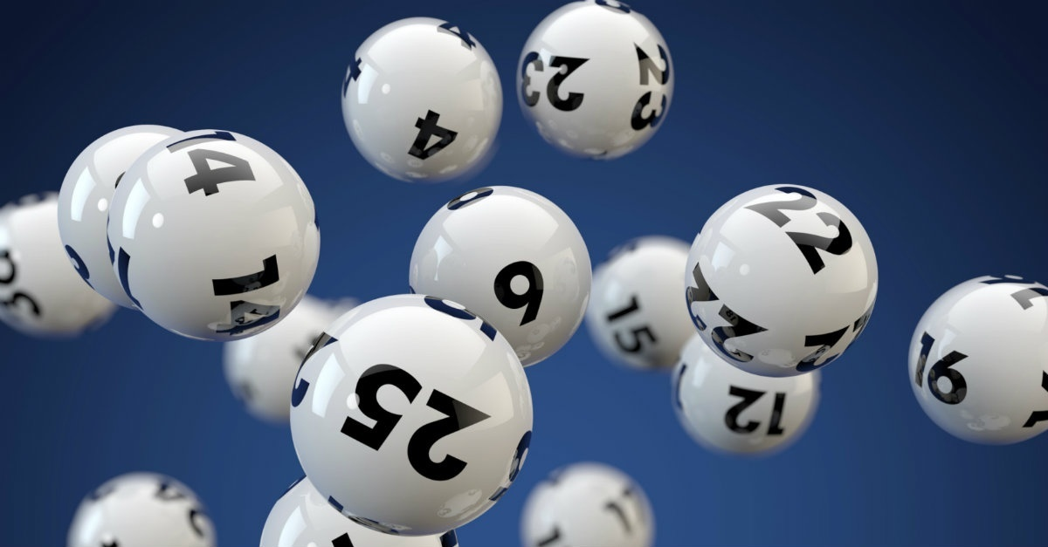
Lottery Contract
Create an interactive lottery system through smart contracts utilizing Solidity
Notes:
Idea + Motivation

Slide 3
1.
Project Background!
Here’s a bit more about our idea.

Slide 4
Objectives
First
Second
Third
Last
Allow multiple addresses to purchase lottery tickets for a set price
Pool the earnings from the ticket purchase
Select a randomized winner
Pay out the earnings to the winner and reset to zero
Notes:
These were the key steps in building our contract.

Slide 5
Definitions
Blockchain
A network of nodes linked peer-to-peer that facilitates transactions similar to a distributed ledger.
Block Hash
A function that converts an input of letters and numbers into an encrypted output.
Smart Contract
Computer code that automatically executes all or parts of an agreement and is stored on a blockchain-based platform.
Wallet Address
A digital wallet used to store cryptocurrencies and conduct secure transactions.
Constructor
A special method that gets called whenever an object of a class is initialized.
Token
A virtual asset or utility that resides on their own blockchain.
Notes:
Block hash is an encrypted output that contains information. It’s how we were able to use a random number generator.
The wallet address is unique to each purchaser so we can choose where to send the money to.
In terms of tokens, we’re using a non-fungible token specifically, which represents a unique lottery ticket.

Slide 6
Coding Roadmap
The Buy function sets the ticket price and pushes each purchaser’s address into the array.
A constructor sets up the token on the Ethereum network.
Lottery proceeds can be withdrawn by the winner.
1
3
5
2
4
6
An array stores the addresses of ticket purchasers.
The index = lottery ticket number.
The contract generates a random number within a set range to determine the winner.
The contract resets everything to zero.
Notes:
A constructor sets up the token on the Ethereum network.
An array called tickets that stores the addresses of the ticket purchasers. The index of each address in the array is the lottery ticket number.
The Buy function sets the purchase price for each lottery ticket and then push the address of each ticket purchaser into the array.
To select a winner, the contract generates a random number by taking the current block number, subtracting 1 and running it through the block hash function to get a number which we converted to an integer. This integer is multiplied by the ticket count to ensure that it falls within the range of the number of tickets purchased, and determines the winner from the array.
Once a winner is chosen, all of the lottery proceeds are assigned to the address corresponding to the lottery winner.
The withdraw function verifies that the address of the person trying to withdraw funds matches the winner, allows them to withdraw their winnings in ether, and then resets their balance to 0 so they can't withdraw more than once.
The code then resets the the ticket count and winnings to zero, and resets/clears the array to start the lottery over again.

Slide 7
Testing
Phase 1
A single person purchased multiple lottery tickets from several accounts. This initial test verified the contract would select a random winner.
Phase 2
Several different individuals purchased lottery tickets. This test verified others could import the contract and buy a ticket.

Slide 8
2.
Demo!
Ethere-UM, you just won the lottery!

Slide 9
Challenges
Getting a random number generator to work.
Determining how to give multiple people the ability to buy tickets.
Conversion rate of Ethereum to our Lottery Token.
Getting prompted by MetaMask to send Ether for the token.

Slide 10
Next Steps
Exchange Rate
Use multiple types of cryptocurrency in the same contract
Other Methods
Have users pick a number to win instead of assigning a random winner
More Security
Restrict certain functionality to the contract owner

Slide 11
Thanks!
Any questions?
We’ll miss you guys.

